Slide 1

《HTML Basics》
周思吉（Zhou SiJi） 2024年12月

Slide 2

one
HTML Forms
Part

Slide 3

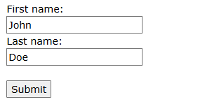
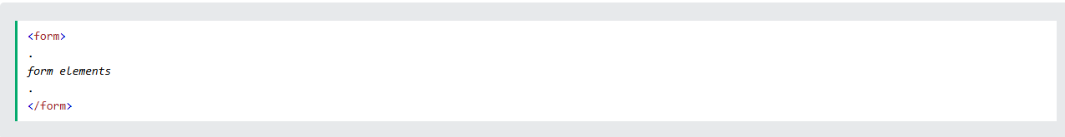
HTML Forms
An HTML form is used to collect user input. The user input is most often sent to a server for processing.
The <form> Element
The HTML <form> element is used to create an HTML form for user input:
The <form> element is a container for different types of input elements, such as: text fields, checkboxes, radio buttons, submit buttons, etc.

Slide 4
HTML Forms
The <input> Element
The HTML <input> element is the most used form element.
An <input> element can be displayed in many ways, depending on the type attribute.
Here are some examples:
Type | Description
<input type="text"> | Displays a single-line text input field
<input type="radio"> | Displays a radio button (for selecting one of many choices)
<input type="checkbox"> | Displays a checkbox (for selecting zero or more of many choices)
<input type="submit"> | Displays a submit button (for submitting the form)
<input type="button"> | Displays a clickable button

Slide 5
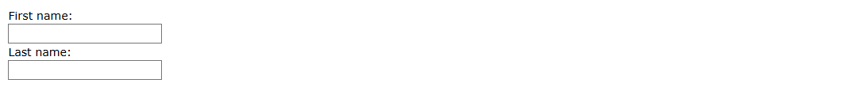
HTML Forms
Text Fields
The <input type="text"> defines a single-line input field for text input.
Example
A form with input fields for text:
<form> <label for="fname">First name:</label><br> <input type="text" id="fname" name="fname"><br> <label for="lname">Last name:</label><br> <input type="text" id="lname" name="lname"> </form>
This is how the HTML code above will be displayed in a browser:
Note: The form itself is not visible. Also note that the default width of an input field is 20 characters.

Slide 6
HTML Forms
The <label> Element
Notice the use of the <label> element in the example above.
The <label> tag defines a label for many form elements.
The <label> element is useful for screen-reader users, because the screen-reader will read out loud the label when the user focuses on the input element.
The <label> element also helps users who have difficulty clicking on very small regions (such as radio buttons or checkboxes) - because when the user clicks the text within the <label> element, it toggles the radio button/checkbox.
The for attribute of the <label> tag should be equal to the id attribute of the <input> element to bind them together.

Slide 7
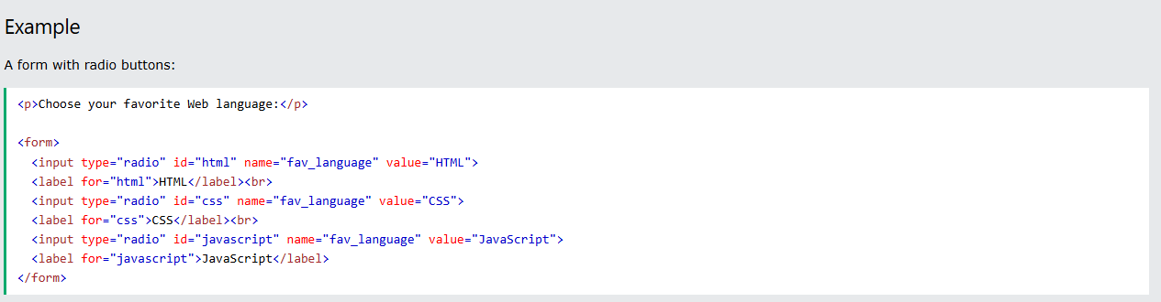
HTML Forms
Radio Buttons
The <input type="radio"> defines a radio button.
Radio buttons let a user select ONE of a limited number of choices.
This is how the HTML code above will be displayed in a browser:

Slide 8
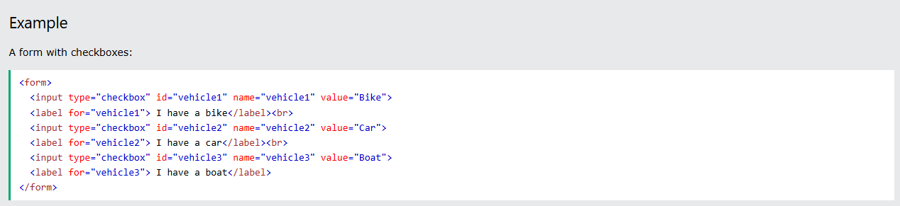
HTML Forms
Checkboxes
The <input type="checkbox"> defines a checkbox.
Checkboxes let a user select ZERO or MORE options of a limited number of choices.
This is how the HTML code above will be displayed in a browser:

Slide 9
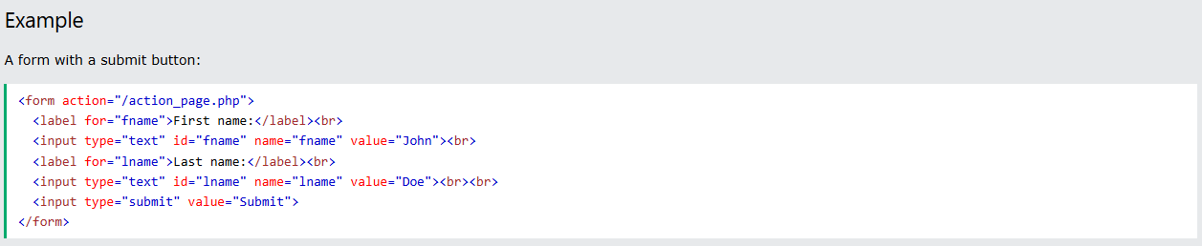
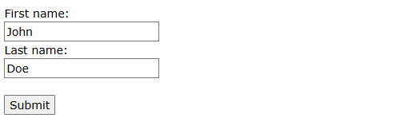
HTML Forms
The Submit Button
The <input type="submit"> defines a button for submitting the form data to a form-handler.
The form-handler is typically a file on the server with a script for processing input data.
The form-handler is specified in the form's action attribute.
This is how the HTML code above will be displayed in a browser:

Slide 10
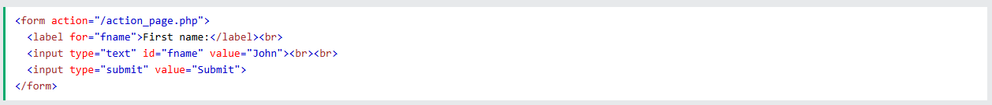
HTML Forms
The Name Attribute for <input>
Notice that each input field must have a name attribute to be submitted.
If the name attribute is omitted, the value of the input field will not be sent at all.
Example
This example will not submit the value of the "First name" input field:
If you click the "Submit" button, the form-data will be sent to a page called "action_page.php".

Slide 11
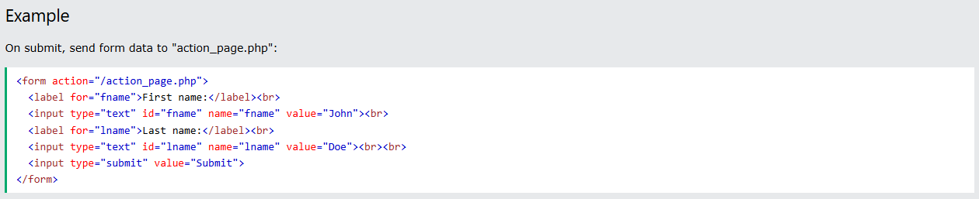
HTML Forms-Attributes
This chapter describes the different attributes for the HTML <form> element.
The Action Attribute
The action attribute defines the action to be performed when the form is submitted.
Usually, the form data is sent to a file on the server when the user clicks on the submit button.
In the example below, the form data is sent to a file called "action_page.php". This file contains a server-side script that handles the form data:
Tip: If the action attribute is omitted, the action is set to the current page.

Slide 12
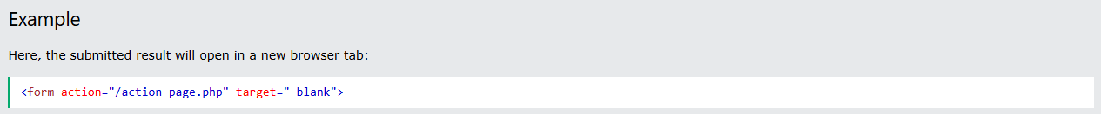
HTML Forms-Attributes
The Target Attribute
The target attribute specifies where to display the response that is received after submitting the form.
The target attribute can have one of the following values:
Value Description
_blank The response is displayed in a new window or tab
_self The response is displayed in the current window
The default value is _self which means that the response will open in the current window.

Slide 13
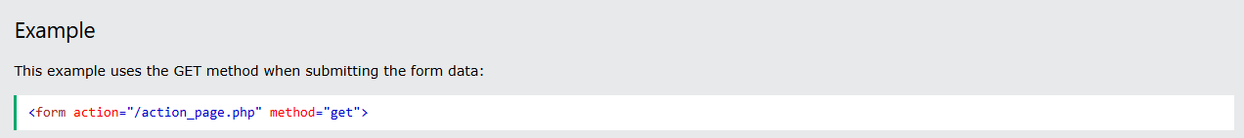
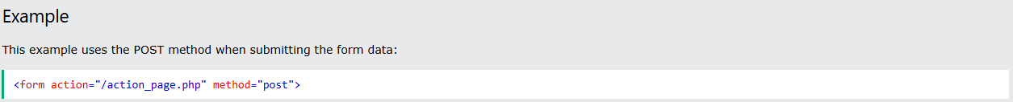
HTML Forms-Attributes
The Method Attribute
The method attribute specifies the HTTP method to be used when submitting the form data.
The form-data can be sent as URL variables (with method="get") or as HTTP post transaction (with method="post").
The default HTTP method when submitting form data is GET.
Notes on GET:
Appends the form data to the URL, in name/value pairs
NEVER use GET to send sensitive data! (the submitted form data is visible in the URL!)
The length of a URL is limited (2048 characters)
GET is good for non-secure data, like query strings in Google or Baidu
Notes on POST:
Appends the form data inside the body of the HTTP request (the submitted form data is not shown in the URL)
POST has no size limitations, and can be used to send large amounts of data.
Tip: Always use POST if the form data contains sensitive or personal information!

Slide 14
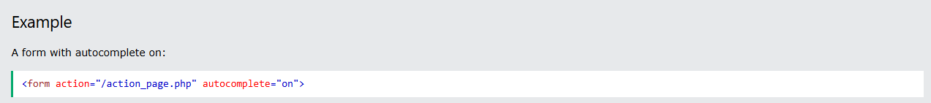
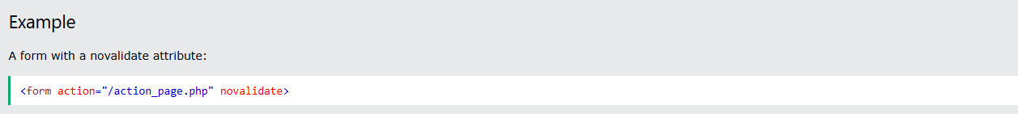
HTML Forms-Attributes
The Autocomplete Attribute
The autocomplete attribute specifies whether a form should have autocomplete on or off.
When autocomplete is on, the browser automatically complete values based on values that the user has entered before.
The Novalidate Attribute
The novalidate attribute is a boolean attribute.
When present, it specifies that the form-data (input) should not be validated when submitted.

Slide 15
HTML Form Elements
This chapter describes all the different HTML form elements.
The HTML <form> Elements
The HTML <form> element can contain one or more of the following form elements:
<input>
<label>
<select>
<textarea>
<button>
<fieldset>
<legend>
<datalist>
<output>
<option>
<optgroup>

Slide 16
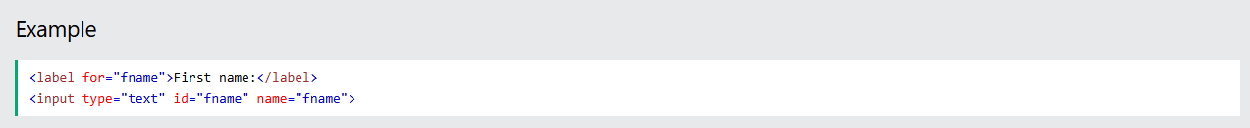
HTML Forms-Attributes
The <input> Element
One of the most used form elements is the <input> element.
The <input> element can be displayed in several ways, depending on the type attribute.

Slide 17
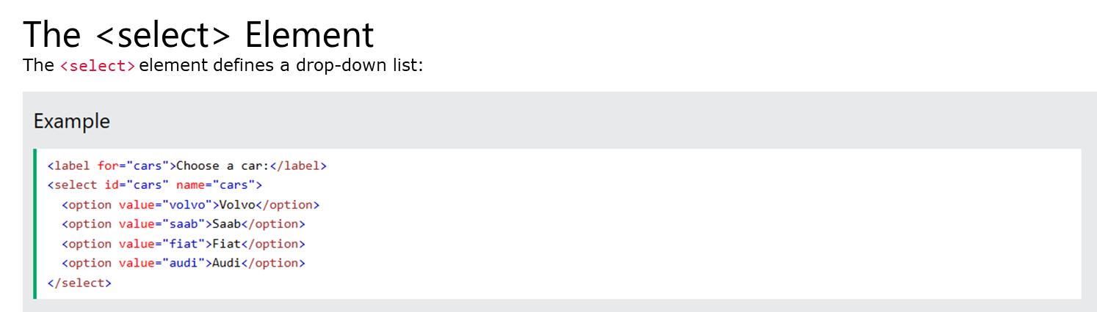
HTML Forms-Attributes
The <option> element defines an option that can be selected.
By default, the first item in the drop-down list is selected.
To define a pre-selected option, add the selected attribute to the option:

Slide 18
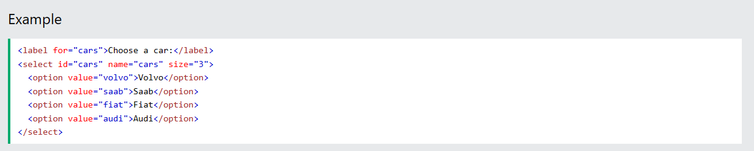
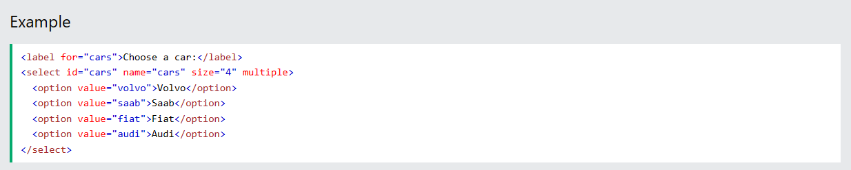
HTML Forms-Attributes
Visible Values:
Use the size attribute to specify the number of visible values:
Allow Multiple Selections:
Use the multiple attribute to allow the user to select more than one value:

Slide 19
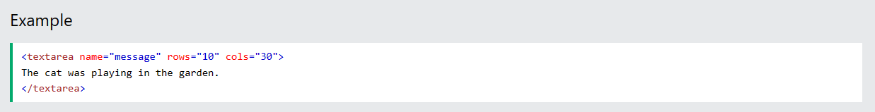
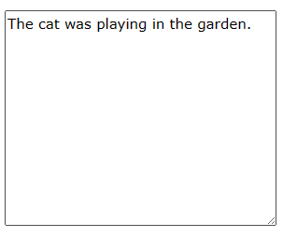
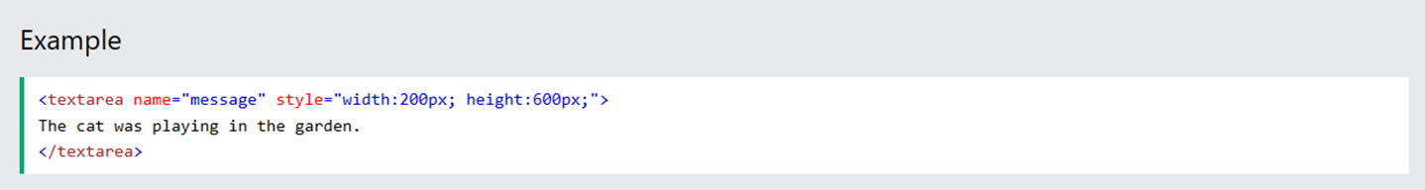
HTML Forms-Attributes
The <textarea> Element
The <textarea> element defines a multi-line input field (a text area):
The rows attribute specifies the visible number of lines in a text area.
The cols attribute specifies the visible width of a text area.
This is how the HTML code above will be displayed in a browser:
You can also define the size of the text area by using CSS:

Slide 20

HTML Forms-Attributes
The <button> Element
The <button> element defines a clickable button:
This is how the HTML code above will be displayed in a browser:
Note: Always specify the type attribute for the button element. Different browsers may use different default types for the button element.

Slide 21
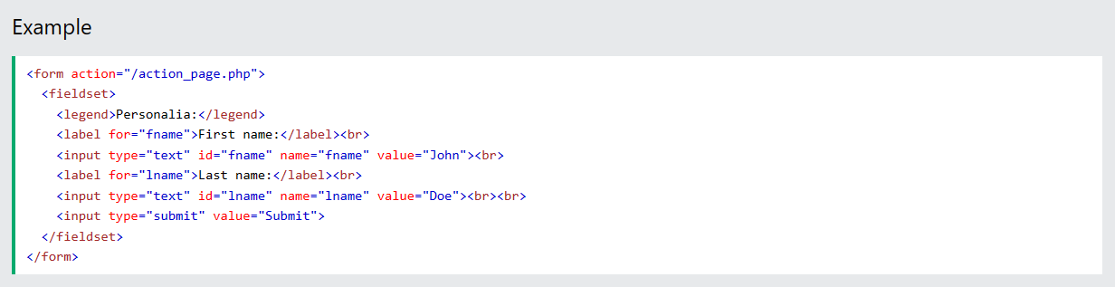
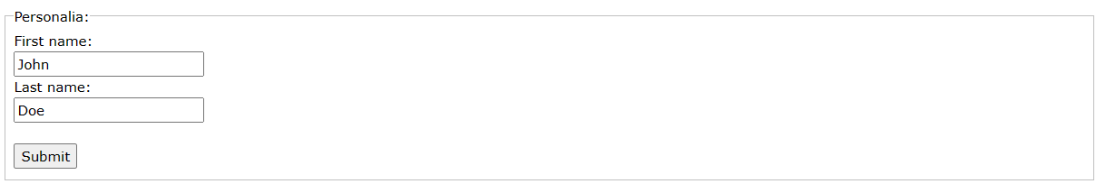
HTML Forms-Attributes
The <fieldset> and <legend> Elements
The <fieldset> element is used to group related data in a form.
The <legend> element defines a caption for the <fieldset> element.
This is how the HTML code above will be displayed in a browser:

Slide 22
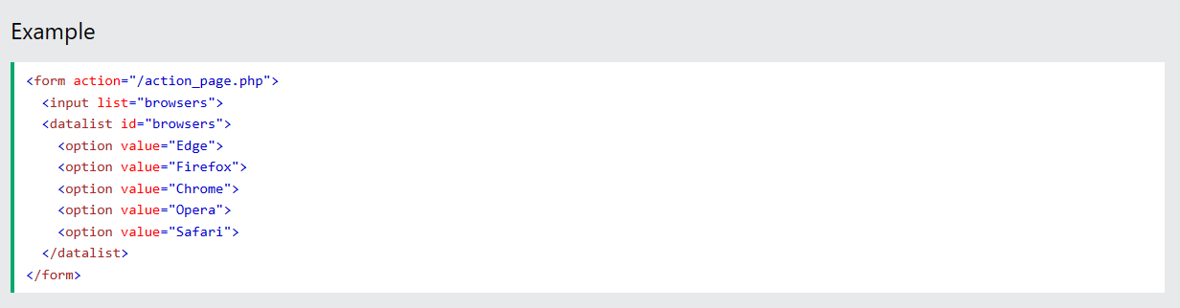
HTML Forms-Attributes
The <datalist> Element
The <datalist> element specifies a list of pre-defined options for an <input> element.
Users will see a drop-down list of the pre-defined options as they input data.
The list attribute of the <input> element, must refer to the id attribute of the <datalist> element.

Slide 23
HTML Forms-HTML Input Types
This chapter describes the different types for the HTML <input> element.
HTML Input Types
Here are the different input types you can use in HTML:
<input type="button">
<input type="checkbox">
<input type="color">
<input type="date">
<input type="datetime-local">
<input type="email">
<input type="file">
<input type="hidden">
<input type="image">
<input type="month">
<input type="number">
<input type="password">
<input type="radio">
<input type="range">
<input type="reset">
<input type="search">
<input type="submit">
<input type="tel">
<input type="text">
<input type="time">
<input type="url">
<input type="week">
Tip: The default value of the type attribute is "text".

Slide 24
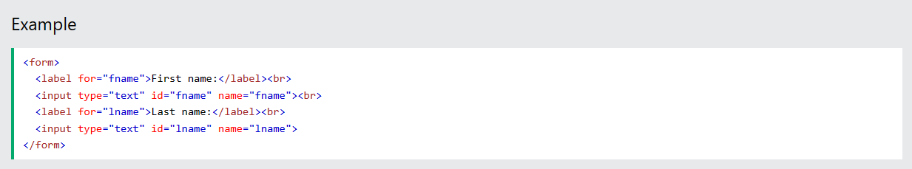
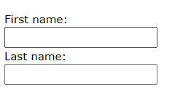
HTML Forms-HTML Input Types
Input Type Text
<input type="text"> defines a single-line text input field:
This is how the HTML code above will be displayed in a browser:

Slide 25
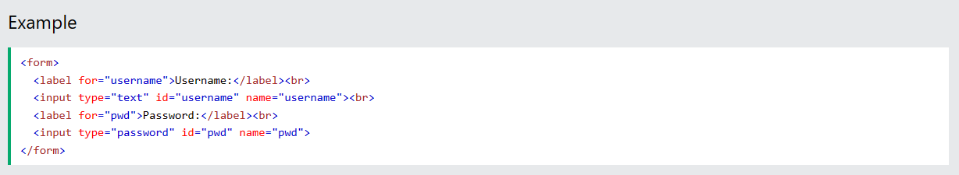
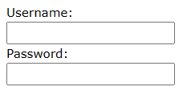
HTML Forms-HTML Input Types
Input Type Password
<input type="password"> defines a password field:
This is how the HTML code above will be displayed in a browser:
The characters in a password field are masked (shown as asterisks or circles).

Slide 26
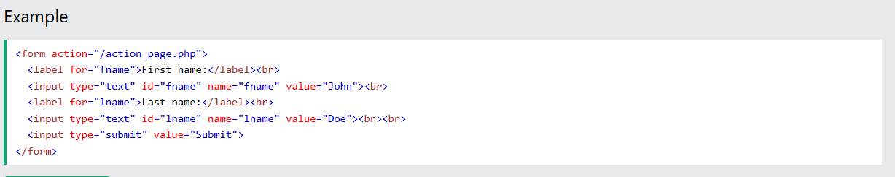
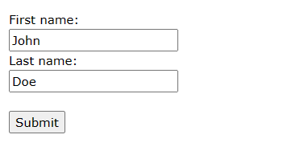
HTML Forms-HTML Input Types
Input Type Submit
<input type="submit"> defines a button for submitting form data to a form-handler.
The form-handler is typically a server page with a script for processing input data.
The form-handler is specified in the form's action attribute:
This is how the HTML code above will be displayed in a browser:

Slide 27
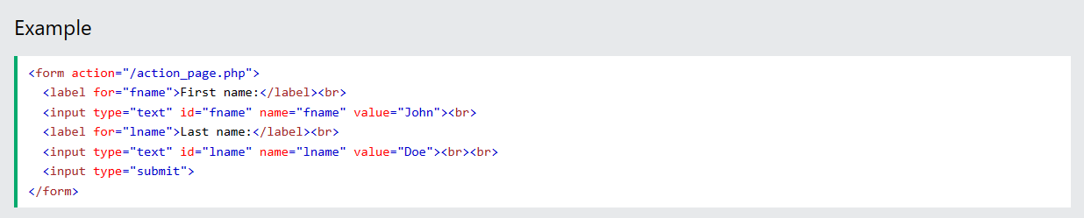
HTML Forms-HTML Input Types
If you omit the submit button's value attribute, the button will get a default text:

Slide 28
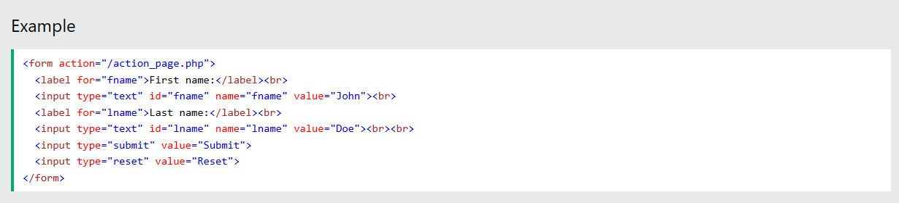
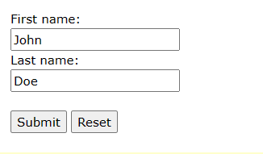
HTML Forms-HTML Input Types
Input Type Reset
<input type="reset"> defines a reset button that will reset all form values to their default values:
This is how the HTML code above will be displayed in a browser:
If you change the input values and then click the "Reset" button, the form-data will be reset to the default values.

Slide 29
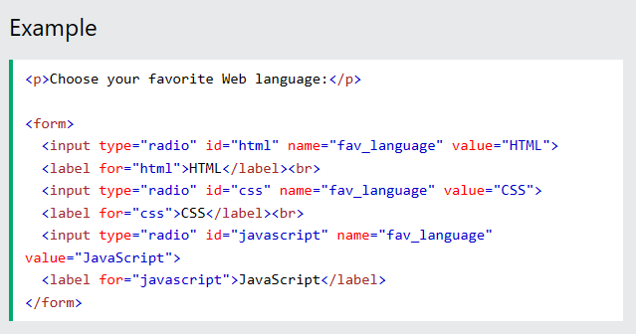

HTML Forms-HTML Input Types
Input Type Radio
<input type="radio"> defines a radio button.
Radio buttons let a user select ONLY ONE of a limited number of choices:
This is how the HTML code above will be displayed in a browser:

Slide 30
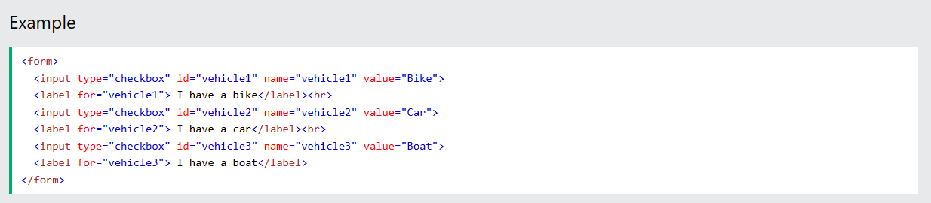
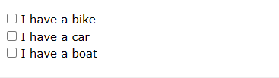
HTML Forms-HTML Input Types
Input Type Checkbox
<input type="checkbox"> defines a checkbox.
Checkboxes let a user select ZERO or MORE options of a limited number of choices.
This is how the HTML code above will be displayed in a browser:

Slide 31

HTML Forms-HTML Input Types
Input Type Button
<input type="button"> defines a button:
This is how the HTML code above will be displayed in a browser:

Slide 32
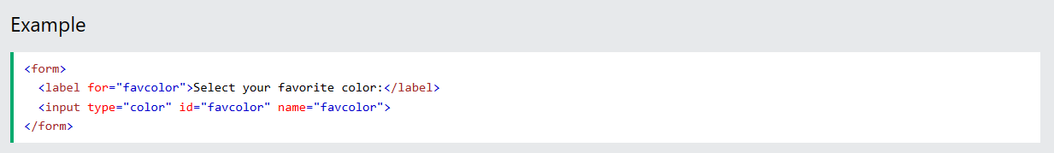
HTML Forms-HTML Input Types
Input Type Color
The <input type="color"> is used for input fields that should contain a color.
Depending on browser support, a color picker can show up in the input field.

Slide 33
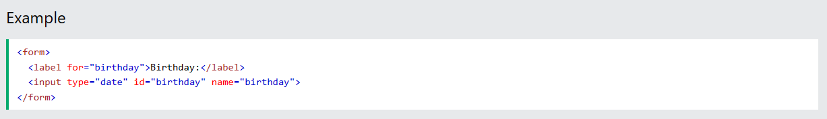
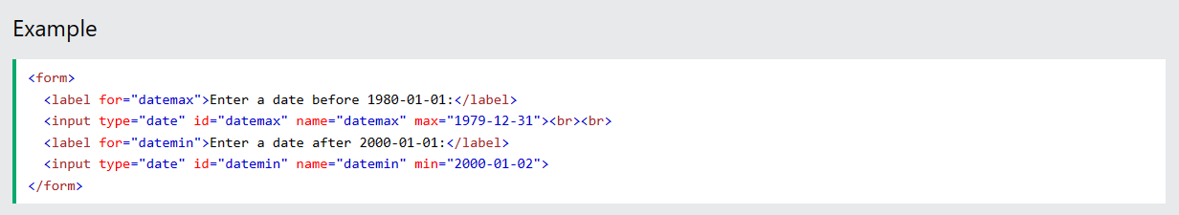
HTML Forms-HTML Input Types
Input Type Date
The <input type="date"> is used for input fields that should contain a date.
Depending on browser support, a date picker can show up in the input field.
You can also use the min and max attributes to add restrictions to dates:

Slide 34
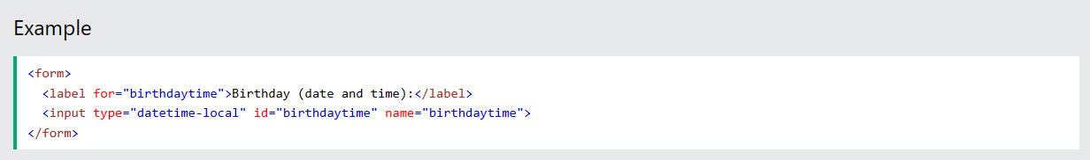
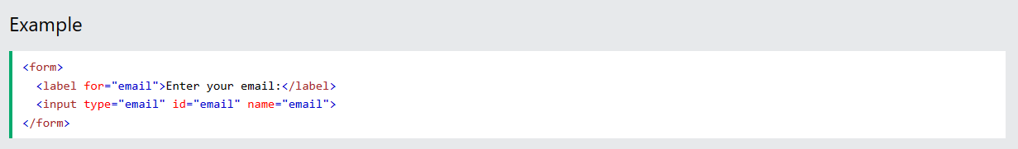
HTML Forms-HTML Input Types
Input Type Datetime-local
The <input type="datetime-local"> specifies a date and time input field, with no time zone.
Depending on browser support, a date picker can show up in the input field.
Input Type Email
The <input type="email"> is used for input fields that should contain an e-mail address.
Depending on browser support, the e-mail address can be automatically validated when submitted.

Slide 35
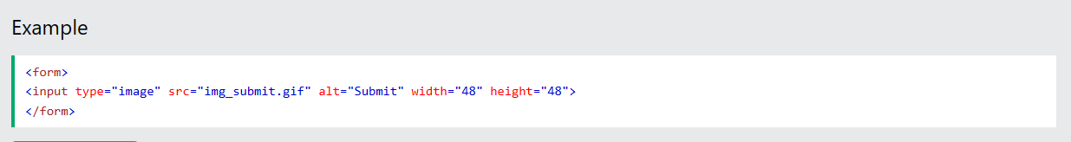
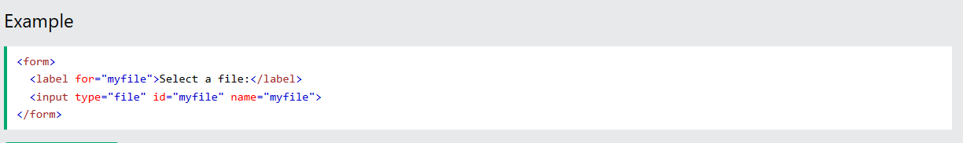
HTML Forms-HTML Input Types
Input Type Image
The <input type="image"> defines an image as a submit button.
The path to the image is specified in the src attribute.
Input Type File
The <input type="file"> defines a file-select field and a "Browse" button for file uploads.

Slide 36
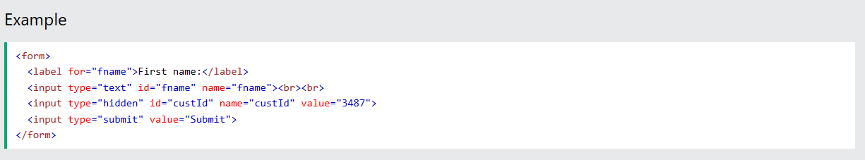
HTML Forms-HTML Input Types
Input Type Hidden
The <input type="hidden"> defines a hidden input field (not visible to a user).
A hidden field lets web developers include data that cannot be seen or modified by users when a form is submitted.
A hidden field often stores what database record that needs to be updated when the form is submitted.
Note: While the value is not displayed to the user in the page's content, it is visible (and can be edited) using any browser's developer tools or "View Source" functionality. Do not use hidden inputs as a form of security!

Slide 37
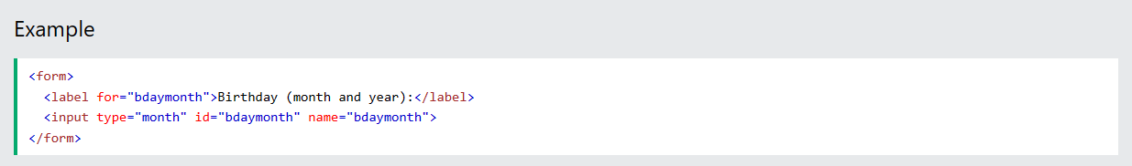
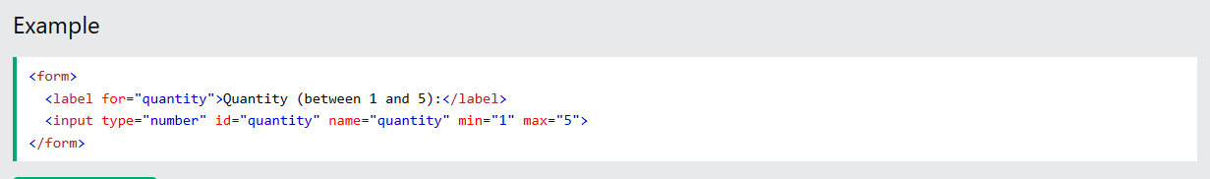
HTML Forms-HTML Input Types
Input Type Month
The <input type="month"> allows the user to select a month and year.
Depending on browser support, a date picker can show up in the input field.
Input Type Number
The <input type="number"> defines a numeric input field.
You can also set restrictions on what numbers are accepted.
The following example displays a numeric input field, where you can enter a value from 1 to 5:

Slide 38
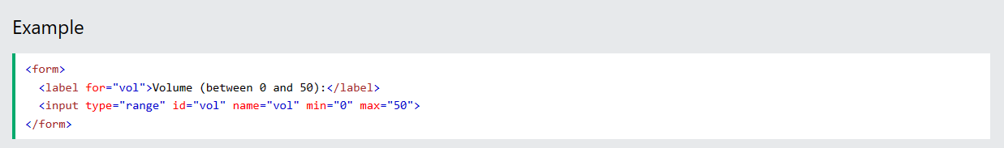
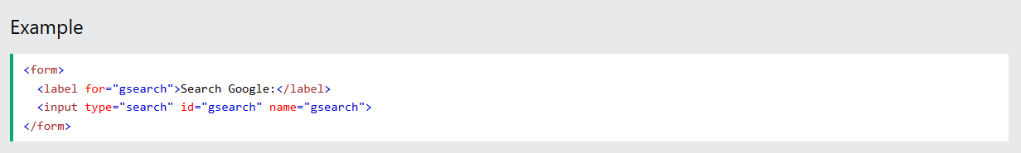
HTML Forms-HTML Input Types
Input Type Range
The <input type="range"> defines a control for entering a number whose exact value is not important (like a slider control). Default range is 0 to 100. However, you can set restrictions on what numbers are accepted with the min, max, and step attributes:
Input Type Search
The <input type="search"> is used for search fields (a search field behaves like a regular text field).

Slide 39
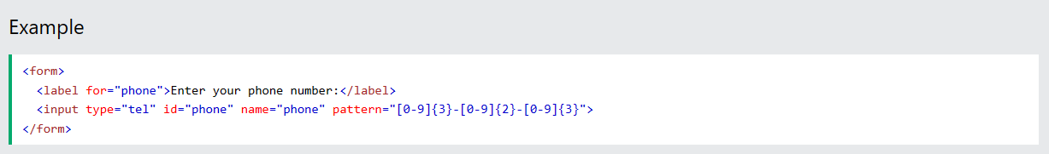
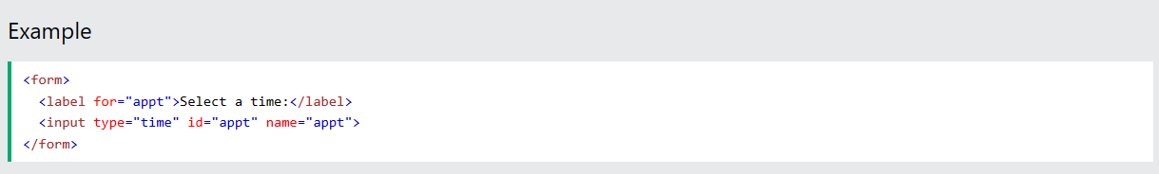
HTML Forms-HTML Input Types
Input Type Tel
The <input type="tel"> is used for input fields that should contain a telephone number.
Input Type Time
The <input type="time"> allows the user to select a time (no time zone).
Depending on browser support, a time picker can show up in the input field.

Slide 40


HTML Forms-HTML Input Types
Input Type Url
The <input type="url"> is used for input fields that should contain a URL address.
Depending on browser support, the url field can be automatically validated when submitted.
Input Type Week
The <input type="week"> allows the user to select a week and year.
Depending on browser support, a date picker can show up in the input field.

Slide 41

HTML Forms-HTML Input Attributes
This chapter describes the different attributes for the HTML <input> element.
The value Attribute
The input value attribute specifies an initial value for an input field:

Slide 42

HTML Forms-HTML Input Attributes
The readonly Attribute
The input readonly attribute specifies that an input field is read-only.
A read-only input field cannot be modified (however, a user can tab to it, highlight it, and copy the text from it).
The value of a read-only input field will be sent when submitting the form!

Slide 43

HTML Forms-HTML Input Attributes
The disabled Attribute
The input disabled attribute specifies that an input field should be disabled.
A disabled input field is unusable and un-clickable.
The value of a disabled input field will not be sent when submitting the form!

Slide 44

HTML Forms-HTML Input Attributes
The size Attribute
The input size attribute specifies the visible width, in characters, of an input field.
The default value for size is 20.
Note: The size attribute works with the following input types: text, search, tel, url, email, and password.

Slide 45

HTML Forms-HTML Input Attributes
The maxlength Attribute
The input maxlength attribute specifies the maximum number of characters allowed in an input field.
Note: When a maxlength is set, the input field will not accept more than the specified number of characters.

Slide 46

HTML Forms-HTML Input Attributes
The multiple Attribute
The input multiple attribute specifies that the user is allowed to enter more than one value in an input field.
The multiple attribute works with the following input types: email, and file.

Slide 47

HTML Forms-HTML Input Attributes
The pattern Attribute
The input pattern attribute specifies a regular expression that the input field's value is checked against, when the form is submitted.
The pattern attribute works with the following input types: text, date, search, url, tel, email, and password.
Tip: Use the global title attribute to describe the pattern to help the user.

Slide 48

HTML Forms-HTML Input Attributes
The placeholder Attribute
The input placeholder attribute specifies a short hint that describes the expected value of an input field (a sample value or a short description of the expected format).
The short hint is displayed in the input field before the user enters a value.
The placeholder attribute works with the following input types: text, search, url, number, tel, email, and password.

Slide 49

HTML Forms-HTML Input Attributes
The required Attribute
The input required attribute specifies that an input field must be filled out before submitting the form.
The required attribute works with the following input types: text, search, url, tel, email, password, date pickers, number, checkbox, radio, and file.

Slide 50

HTML Forms-HTML Input Attributes
The step Attribute
The input step attribute specifies the legal number intervals for an input field.
Example: if step="3", legal numbers could be -3, 0, 3, 6, etc.
Tip: This attribute can be used together with the max and min attributes to create a range of legal values.
The step attribute works with the following input types: number, range, date, datetime-local, month, time and week.

Slide 51

HTML Forms-HTML Input Attributes
The autofocus Attribute
The input autofocus attribute specifies that an input field should automatically get focus when the page loads.

Slide 52

HTML Input form* Attributes
This chapter describes the different form* attributes for the HTML <input> element.
The formaction Attribute
The input formaction attribute specifies the URL of the file that will process the input when the form is submitted.
Note: This attribute overrides the action attribute of the <form> element.
The formaction attribute works with the following input types: submit and image.

Slide 53

HTML Input form* Attributes
The formtarget Attribute
The input formtarget attribute specifies a name or a keyword that indicates where to display the response that is received after submitting the form.
Note: This attribute overrides the target attribute of the <form> element.
The formtarget attribute works with the following input types: submit and image.

Slide 54
exercise
Complete the exercise

Slide 55

感谢聆听！

